Slide 1
Data Science 100 Final Review (Part 1)
?
Slides by:
Joseph E. Gonzalez, Deb Nolan, & Fernando Perez
jegonzal@berkeley.edu

Slide 2
Logistics

Slide 3
When: 8:00AM – 11:00AM Thursday, May 10th
That is so early!
We agree!
Set an alarm
Set a second alarm
Call a friend and ask them to set an alarm
Go to bed at a reasonable hour

Slide 4
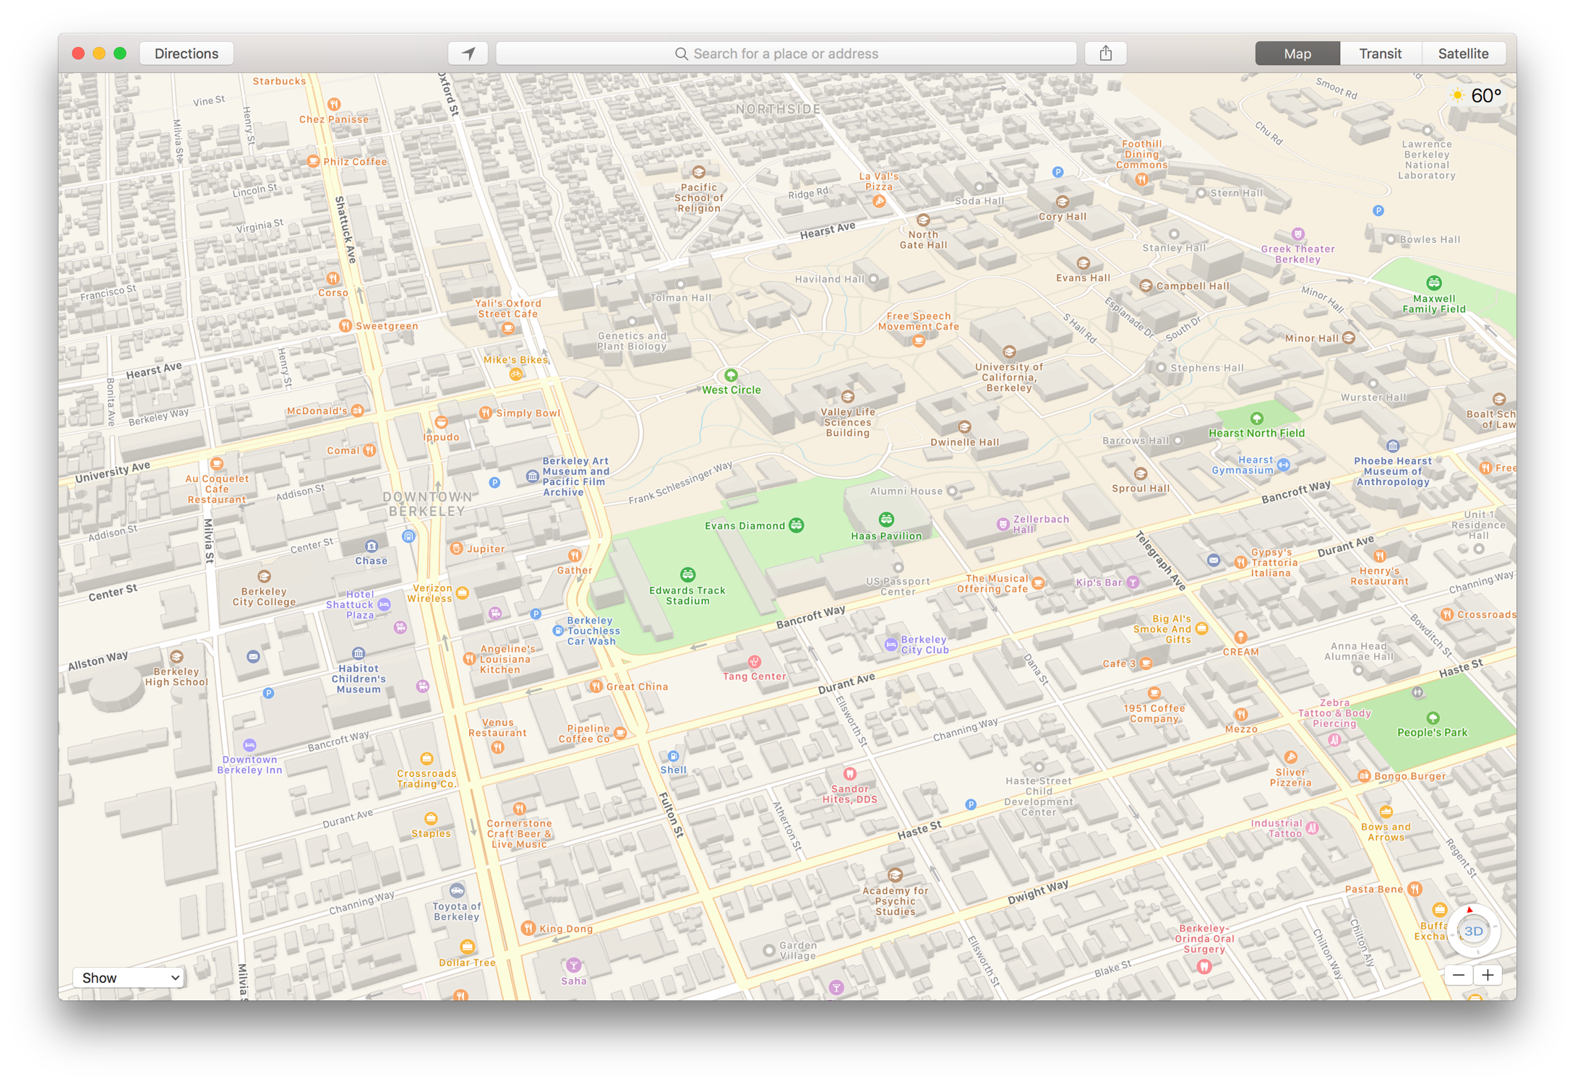
Where: RSF Field House

Slide 5
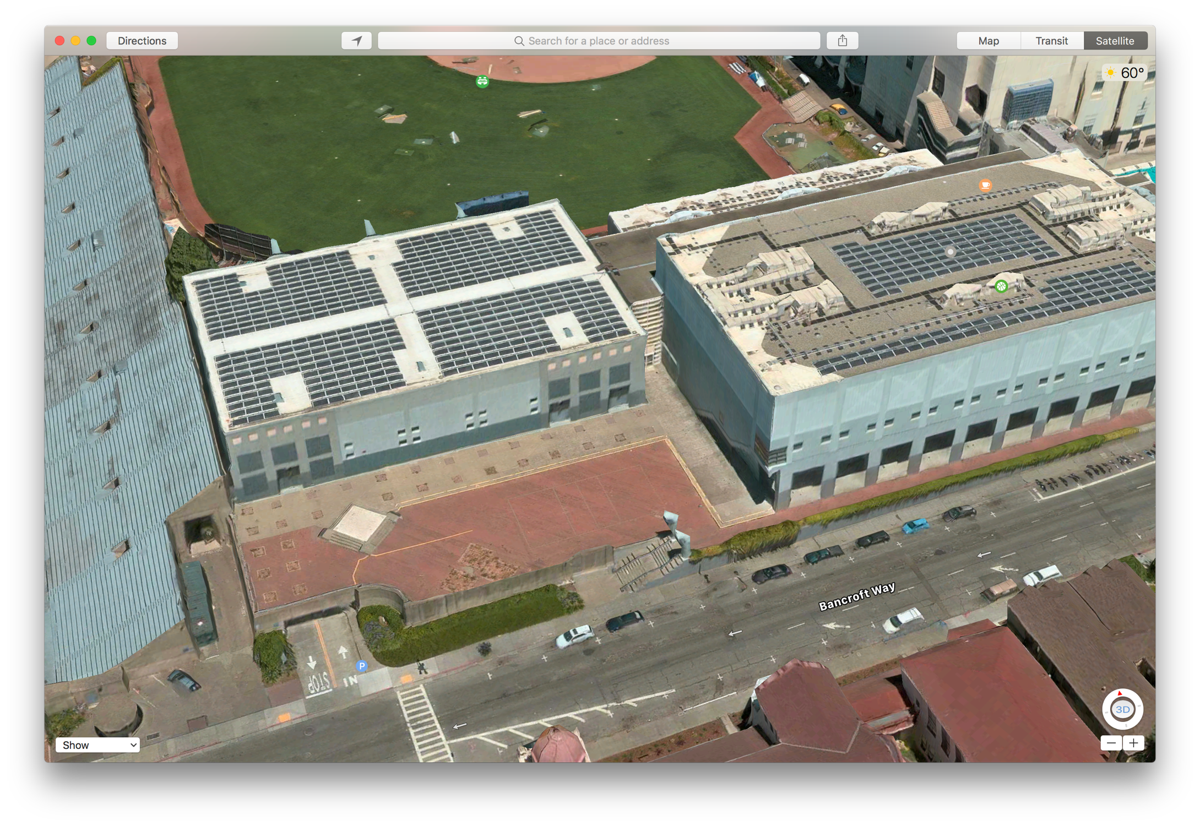
Line up here

Slide 6
What to Bring
Cal ID Card
Pencils and Erasers
A two page study guide (more on this in a moment)
No food or drink is allowed in RSF Fieldhouse

Slide 7
How to make a Study Guide
We don’t call it a cheat sheet. Why?
Cheating is bad … Don’t cheat.
Goal: after you make it you don’t need it
You could just miniaturize all the lectures but this would not help you study.
Go over lectures, HWS, projections, sections, and labs
Try to explain the material to your friends (real and imagined)
Write big concepts, technical ideas, terminology, & definitions.
Think about how things are arranged.
You should be able to explain everything on your guide

Slide 8
What is the format?
Same format as the midterm: largely multiple choice and very short answer
You will not need to write long programs
You will need to read Python, SQL, and Regular expressions (find bugs, explain what they do, match with output …)
For Python APIs and Regex syntax we will provide a reference sheet (same as midterm).

Slide 9
What is covered on the final?
Everything!
… except Apache Spark ☹ [which I really like]
… but you should know MapReduce concepts ☺
This includes material before the midterm. (Review the midterm!)
This exam review covers material up to the midterm
Thursday will cover material after the midterm

Slide 10
Material Before the Midterm
Data Sampling and Collection
Pandas Indexes, DataFrames Series, Pivot Tables, Group By, and Merge
Exploratory Data Analysis and Data Cleaning
Data Visualization and plotting
Web technologies (http and requests)
Regular Expressions
SQL
Modeling and Estimation (Loss functions)
Gradient Descent

Slide 11
Breakdown by Question
Modeling and Estimation
Review Sampling
Practice Regex

Slide 12
Sampling the Population

Slide 13
Data Collection and Sampling
Census: the complete population of interest
Important to identify the population of interest
Probability Samples:
Simple Random Sample (SRS): a random subset where every subset has equal chance of being chosen
Stratified Sample: population is partition into strata and a SRS is taken within each strata
Samples from each strata don’t need to be the same size
Cluster Sample: divide population into groups, take an SRS of groups, and elements from each group are selected
Often take all elements (one-stage) may sample within groups (two-stage)

Slide 14
Non Probability Samples
Administrative Sample: data collected to support an administrative purpose and not for research
Bigger isn’t always better → bias still an issue at scale
Voluntary Sample: self-selected participation
Sensitive to self selection bias
Convenience Sample: the data you have …
often administrative

Slide 15
Code Python + Numpy + Pandas + Seaborn + SQL + Regex +HTTP

Slide 16
Pandas
Review column selection and Boolean slicing on rows
Review groupby, merge, and pivot_table:
df.groupby([‘state’, ‘gender’])[[‘age’, ‘height’]].mean()
dfA.merge(dfB, on=‘key’, how=‘outer’)
df.pivot_table(index, columns, values, aggfunc, fill_value)
Understand rough usage of basic plotting commands
plot, bar, histogram …
sns.distplot

Slide 17
Group By – manipulating granularity
Key
Data
A
3
A
3
A
1
Aggregate
Function
A
6
B
1
A
2
C
4
A
6
A
1
B
1
Split into
Groups
Merge
Results
B
12
B
5
B
5
Aggregate
Function
B
12
C
18
C
9
B
6
A
2
C
4
B
6
Aggregate
Function
C
9
C
18
C
5
C
5

Slide 18
Pivot – A kind of Group By Operation
Key R
Key
C
A
U
3
Data
Aggregate
Function
A
U
5
A
U
3
A
U
2
B
V
1
Aggregate
Function
A
V
1
U
V
A
V
1
A
1
C
U
4
Aggregate
Function
A
5
B
U
5
B
U
5
A
V
1
B
5
7
Split into
Groups
B
V
1
Aggregate
Function
B
V
7
B
U
5
C
4
9
B
V
6
C
V
9
D
5
C
U
4
Aggregate
Function
C
U
4
A
U
2
Need to address missing values
C
V
9
Aggregate
Function
C
V
9
B
V
6
D
U
5
D
U
5
Aggregate
Function
D
U
5

Slide 19
Joining data across tables
Joins are a way to connect data across multiple tables
Purchases.csv
Products.csv
OrderNum | ProdID | Quantity
1 | 42 | 3
1 | 999 | 2
2 | 42 | 1
⨝
ProdID | Cost
42 | 3.14
999 | 2.72
Join
Joined Table
OrderNum | ProdID | Quantity | Cost
1 | 42 | 3 | 3.14
1 | 999 | 2 | 2.72
2 | 42 | 1 | 3.14
=

Slide 20
EDA & Data Visualization

Slide 21
Kinds of
Data
Note that categorical data can also be numbers and quantitative data may be stored as strings.
Categorical Data
Quantitative Data
Numbers with meaning ratios or intervals.
Ordinal
Nominal
Examples:
Price
Quantity
Temperature
Date
…
Categories with orders but no consistent meaning if magnitudes or intervals
Categories with no
specific ordering.
Examples:
Preferences
Level of education
…
Examples:
Political Affiliation
CalD number
…

Slide 22
Visualizing Univariate Relationships
Quantitative Data
Histograms, Box Plots, Rug Plots, Smoothed Interpolations (KDE – Kernel Density Estimators)
Look for symmetry, skew, spread, modes, gaps, outliers…
Nominal & Ordinal Data
Bar plots (sorted by frequency or ordinal dimension)
Look for skew, frequent and rare categories, or invalid categories
Consider grouping categories and repeating analysis

Slide 23
Histograms, Rug Plots, and KDE Interpolation
Describes distribution of data – relative prevalence of values
Histogram
relative frequency of values
Tradeoff of bin sizes
Rug Plot
Shows the actual data locations
Smoothed density estimator
Tradeoff of “bandwidth” parameter (more on this later)
Main Mode
Smoothed Density Estimator
Second Mode
Skew Right
Histogram
Outliers
Gap
Rug

Slide 24
Techniques of Visualization
Scale: ranges of values and how they are presented
Units, starting points, zoom, …
Conditioning: breakdown visualization across dimensions for comparison (e.g., separate lines for males and females)
Perception
Length: encode relative magnitude (best for comparison)
Color: encode conditioning and additional dimensions and
Transformations: to linearize relationships highlight important trends
Symmetrize distribution
Linearize relationships (e.g., Tukey Mosteller Bulge)
Things to avoid stacking, jiggling, chart junk, and over plotting

Slide 25
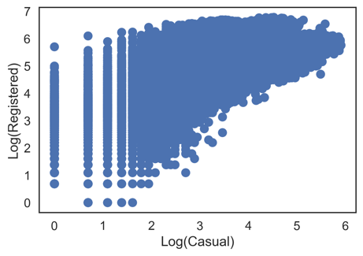
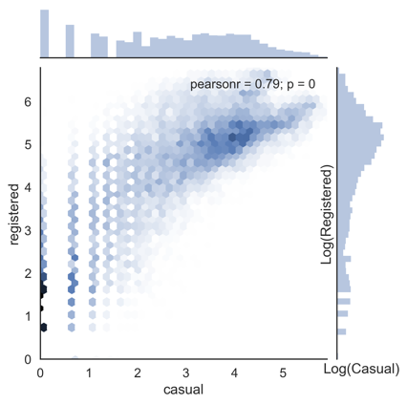
Bad Plot Terminology
Over plotting
Pie charts → Bar charts
Eliminate Stacking and Jiggling
Chart Junk
Area
Perception + Chart Junk

Slide 26
Linearizing Relationships
Log(x)
Log(x)
Log(y)
Log(y)

Slide 27
Dealing with Big Data
Big n (many rows)
Aggregation & Smoothing – compute summaries over groups/regions
Sliding windows, kernel density smoothing
Set transparency or use contour plots to avoid over-plotting
Big p (many columns)
Create new hybrid columns that summarize multiple columns
Example: total sources of revenue instead of revenue by product
Use dimensionality reduction techniques to automatically derive columns that preserve the relationships between records (e.g., distances)
PCA – not required to know PCA for the exam.

Slide 28
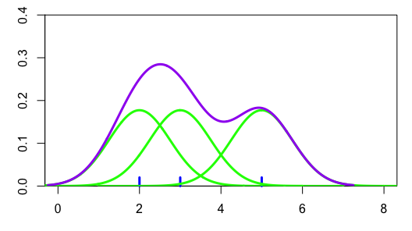
Kernel Density Estimator
Sum the 3 kernels at each point to get the density curve
Gaussian Kernels

Slide 29
Web Technologies XML/JSON/HTTP/REST

Slide 30
Request – Response Protocol
GET /sp18/syllabus.html?a=1 HTTP/1.1
HOST: ds100.org
…
Header
Client
Server
Request
Swipe
Response
HTTP/1.1 200 OK
Server: GitHub.com
Date: Mon, 12 Feb 2018 05:41:55 GMT
…
Header
<!DOCTYPE html><html lang="en"> <head> <meta charset="utf-8"> <meta http-equiv="X-UA-Compatible" content="IE=edge"> <title>DS100</title><meta name="author" content="UC Berkeley"> > …
Body

Slide 31
Request Types (Main Types)
Know differences between put and get
GET – get information
Parameters passed in URI (limited to ~2000 characters)
/app/user_info.json?username=mejoeyg&version=now
Request body is typically ignored
Should not have side-effects (e.g., update user info)
Can be cached in on server, network, or in browser (bookmarks)
POST – send information
Parameters passed in URI and BODY
May and typically will have side-effects
Often used with web forms.

Slide 32
HTML/XML/JSON
Most services will exchange data in HTML, XML, or JSON
Nested data formats (review JSON notebook)
Understand how JSON objects map to python objects (HWs)
JSON List → Python List
JSON Dictionary → Python Dictionary
JSON Literal → Python Literal
Review basic XML formatting requirements:
Well nested tags, no spaces, case sensitive,
Be able to read XML and JSON and identify basic bugs

Slide 33
String Manipulation and Regular Expressions

Slide 34
Regex Reference Sheet
^ match beginning of string (unless used for negation [^ … ])
$ match end of string character
? match preceding character or subexpression at most once
+ match preceding character or subexpression one or more times
* match preceding character or subexpression zero or more times
. matches any character except newline
[ ] match any single character inside
- match a range of characters [a-c]
( ) used to create sub-expressions
\b match boundary between words
\w match a ”word” character (letters, digits, underscore). \W is the complement
\s match a whitespace character including tabs and newlines. \S is the complement
\d match a digit. \D is the complement
You should know these.

Slide 35
Greedy Matching
Greedy matching: * and + match as many characters as possible using the preceding subexpression in the regular expression before going to the next subexpression.
Example
<.*> matches <body>text</body>
? The modifier suffix makes * and + non-greedy.
<.*?> matches <body>text</body>

Slide 36
Suggested Practice
https://www.w3resource.com/python-exercises/re/
Try running regular expression on the midterm through:
https://regex101.com/
Don’t forget to switch to python mode.
r”\d\d/\d\d/\d{4}”
Dates
r”\w*’\w”
Don’t
r”[Aa]naly[zs]e”
Analyze Analyse

Slide 37
SQL

Slide 38
Relational Terminology
Database: Set of Relations (i.e., one or more tables)
Attribute (Column)
Tuple (Record, Row)
Relation (Table):
Schema: the set of column names, their types, and any constraints
Instance: data satisfying the schema
Schema of database is set of schemas of its relations

Slide 39
Conceptual SQL Evaluation
SELECT [DISTINCT] target-list
FROM relation-list
WHERE qualification
GROUP BY grouping-list
HAVING group-qualification
Try Queries Here
http://sqlfiddle.com/#!17/67109/12
Form groups & aggregate
GROUP BY
[DISTINCT]
Eliminate duplicates
Project away columns
(just keep those used in SELECT, GBY, HAVING)
Apply selections
(eliminate rows)
WHERE
SELECT
One or more tables to use
(cross product …)
Eliminate groups
FROM
HAVING

Slide 40
Kinds of Joins
Inner Joins
Left Joins
Right Joins
Outer Join
Review the slides and syntax for each join type
SELECT r.sid, b.bid, b.bname FROM Reserves3 r FULL JOIN Boats2 b ON r.bid = b.bid
Result:
Boats2
sid | bid | bname
22 | 101 | Interlake
95 | 103 | Clipper
38 | (null) | (null)
(null) | 104 | Marine
(null) | 102 | Interlake
bid | bname | color
101 | Interlake | blue
102 | Interlake | red
103 | Clipper | green
104 | Marine | red
Reserves3
sid | bid | day
22 | 101 | 1996-10-10
95 | 103 | 1996-11-12
38 | 42 | 2010-08-21

Slide 41
Putting it all together
SELECT c.name, AVG(g.grade) AS avg_g, COUNT(*) AS size FROM grades AS g, classes AS c WHERE g.class_id = c.class_id AND g.year = “2006” GROUP BY g.class_id HAVING COUNT(*) > 2 ORDER BY avg_g DESC
What does this compute?
GROUP BY
[DISTINCT]
WHERE
SELECT
FROM
HAVING

Slide 42
Modeling and Estimation

Slide 43
Summary of Model Estimation
Define the Model: simplified representation of the world
Use domain knowledge but … keep it simple!
Introduce parameters for the unknown quantities
Define the Loss Function: measures how well a particular instance of the model “fits” the data
We introduced L², L¹, and Huber losses for each record
Take the average loss over the entire dataset
Minimize the Loss Function: find the parameter values that minimize the loss on the data
Analytically using calculus
Numerically using gradient descent

Slide 44
Linear Models
One of the most widely used tools in machine learning and data science
Model
Linear in the Parameters
Feature Functions
Squared Loss
Loss Minimization
We will return to solving this soon!

Slide 45
Linear Models and Feature Functions
Linear in the Parameters
Feature Functions
Designing the feature functions is a big part of machine learning and data science.
Feature Functions
capture domain knowledge
substantial contribute to expressivity (and complexity)

Slide 46
Linear Models and Feature Functions
Linear in the Parameters
Feature Functions
For Example:
Domain:
Model:
Designing the feature functions is a big part of machine learning and data science.
Feature Functions
capture domain knowledge
substantial contribute to expressivity (and complexity)
Features:
Adding a “constant” feature function
is a common method to introduce an offset (also sometimes called bias) term.

Slide 47
Linear Models and Feature Functions
Linear in the Parameters
Feature Functions
For Example:
Features:
← This is a linear model!
Linear in the parameters

Slide 48
Linear Models and Feature Functions
Linear in the Parameters
Feature Functions
For Example:
Features:
← This is a linear model!
Linear in the parameters

Slide 49
Loss Functions
Loss function: a function that characterizes the cost, error, or loss resulting from a choice of model and parameters.
Squared Loss (L²)
Absolute Loss (L²)
Huber Loss
Smooth,
Sensitive to Outliers
Non-smooth,
Robust
Smooth,
Robust

Slide 50
The Average Cross Entropy Loss
This came after the Midterm but is reviewed here for fun
If y_{i} = 1
If y_{i} = 0
Prb y_{i} = 1
Prb y_{i} = 0

Slide 51
Loss Function
We want our model to be close to the data:
Kullback–Leibler (KL) divergence for classification
For a single (x,y)
Average cross entropy loss
 | Cute | Not Cute
Observed Probability
Predicted Probability
Cross Ent.
Cute Cat Example
x =
, y = 1 “cute"
= 1.0
= 0.0
= 0.8
= 0.2
-1.0 Log(0.8)
≈ 0.22
-0.0 Log(0.2)
= 0.0
Also called the log loss because it is the log of the predicted probability for the true class

Slide 52
Loss Function
We want our model to be close to the data:
Kullback–Leibler (KL) divergence for classification
For a single (x,y)
Average cross entropy loss
 | Cute | Not Cute
Observed Probability
Predicted Probability
Cross Ent.
Cute Cat Example
x =
, y = 0 “not cute"
= 0.0
= 1.0
= 0.7
= 0.3
-0.0 Log(0.7)
= 0.0
-1.0 Log(0.3)
≈ 1.20
Also called the log loss because it is the log of the predicted probability for the true class

Slide 53
Example: Minimizing Average L² Loss
Average Loss (L²)
Set derivative = 0 and solve for θ…
1.
3.
Derivative of the Average Loss (L²)
2.

Slide 54
Essential Calculus: The Chain Rule
How do I compute the derivative of composed functions?
Derivative of f evaluated at g(θ)
Derivative of g(θ)
Know how to calculate derivatives of logs, exponents, and exponentials.

Slide 55
Exercise of Calculus
Minimize:
Take the derivative:

Slide 56
Exercise of Calculus
Minimize:
Take the derivative:
Set derivative equal to zero and solve for parameter
Solving for
parameters

Slide 57
Convex sets and polygons
Convex
Not Convex

Slide 58
Formal Definition of Convex Functions
Epigraph
Epigraph
All possible orange lines are:
always in epigraph or on black line
always above or equal to black line
Convex
Nonconvex
A function f is convex if and only if:

Slide 59
Sum of Convex Functions is Convex
Bonus material (not covered in lecture) but useful for studying

Slide 60
Formal Proof
Suppose you have two convex functions f and g:
We would like to show:
Where:
Bonus material (not covered in lecture) but useful for studying

Slide 61
Formal Proof
Suppose you have two convex functions:
We would like to show:
Where:
Starting on the left side
Substituting definition of h:
Re-arranging terms:
Convexity in f
Convexity in g
Definition of h
Bonus material (not covered in lecture) but useful for studying

Slide 62
Minimizing the Loss
Calculus techniques can be applied generally …
Guaranteed to minimize the loss when loss is convex in the parameters
May not always have an analytic solution …

Slide 63
Gradient Descent

Slide 64
Intuition
Loss
Goal: Minimize the loss by turning the knobs.
Try the loss game (its free)!

Slide 65
Intuition
Loss
Try the loss game (you can’t lose)!

Slide 66
Intuition
Loss
Try the loss game (your loss will be minimal)!

Slide 67
Intuition
Loss
Try the loss game (victory without loss)!

Slide 68
Intuition
Loss

Slide 69
Intuition
Loss
What if we knew which way to turn the knob and an idea of how far?
This is the Gradient!
Try the loss game (its free)!

Slide 70
Intuition
Loss
Try the loss game (its free)!

Slide 71
Intuition
Loss
Try the loss game (its free)!

Slide 72
Intuition
Loss
Try the loss game (its free)!

Slide 73
Intuition
Loss
Try the loss game (its free)!

Slide 74
Intuition
Loss
This is the Gradient descent algorithm!
Try the loss game (its free)!

Slide 75
Quick Review: Gradients
Loss function
For Example:
Gradient:

Slide 76
Gradient Descent Intuition
Loss
Initial Guess
L(θ)
gradient = “slope”
What if I want to decrease the loss?
Gradient points in parameter direction of greatest increase
Slope
Notice slope is negative and steep!

Slide 77
Gradient Descent Intuition
L(θ)
Loss
-gradient
How far should we go?
Gradient = 0
Simple, fast, and works well in high dimensions.

Slide 78
The Gradient Descent Algorithm
initial vector (random, zeros …)
For 𝜏 from 0 to convergence:
Evaluated
at
ρ(𝜏) is the step size (learning rate)
typically 1/𝜏
Converges when gradient is ≈ 0 (or we run out of patience)

Slide 79
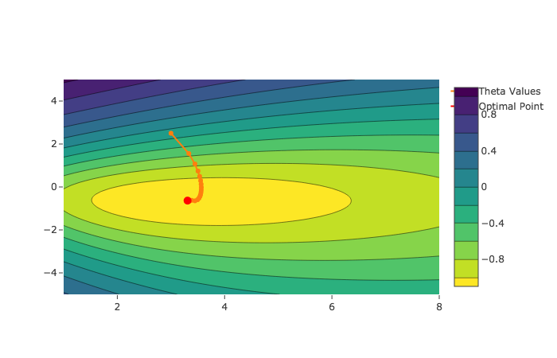

Gradient Descent Solution Paths
Orange line is path taken by gradient descent
Contours are from loss on two parameter model
“Good” Step Sizes
Overshooting

Slide 80
Stochastic Gradient Descent
This came after the Midterm but is reviewed here because it makes sense.
For many learning problems the gradient is a sum:
For large n this can be expensive to compute
What if we approximated the gradient by looking at a few random points:

Slide 81
Stochastic Gradient Descent
For many learning problems the gradient is a sum:
For large n this can be costly
What if we approximated the gradient by looking at a few random points:
Batch
Size
Random sample of records
This is a reasonable estimator for the gradient
Unbiased …
Often batch size is one! (why is this helpful)
Fast to compute!
A key ingredient in the recent success of deep learning

Slide 82
Stochastic Gradient Descent
initial vector (random, zeros …)
For 𝜏 from 0 to convergence:
Decomposable
Loss
Loss can be written as a sum of the loss on each record.

Slide 83
initial vector (random, zeros …)
For 𝜏 from 0 to convergence:
Gradient Descent
Very Similar Algorithms
initial vector (random, zeros …)
Assuming Decomposable Loss Functions
For 𝜏 from 0 to convergence:
Stochastic Gradient Descent

Slide 84
Gradient Descent

Slide 85
Stochastic Gradient Descent

Slide 86
Basics of Random Variables
(Right after the midterm)

Slide 87
Characterizing Random Variables
Probability Mass Function (Discrete Distribution)
The probability a variable will take on a particular value
Probability Density Function (Continuous Distributions)
The probability a variable takes on a range of values.
Not covered … here there be dragons
Expectation
The average value the variable takes (the mean)
Variance
The spread of the variable about the mean

Slide 88
Expected Value and Linearity of Expectation
Summary
Expected Value
Linearity of Expectation
independence not required
If X and Y are independent then

Slide 89
The Variance
Properties of Variance:
If X and Y are independent:

Slide 90
The Variance
Properties of Variance:
If X and Y are independent:
Standard Deviation (easier to interpret units)
Useful identity

Slide 91
Binary Random Variable (Bernoulli)
Takes on two values (e.g., (0,1), (heads, tails)…)
Characterized by probability p
Expected Value:
Variance
Value | 1 | 0
Chance | p | 1-p

Slide 92
Generalization
The focus of the next few lectures.

Slide 93
A Simple Example
I like to eat shishito peppers
Usually they are not too spicy …
but occasionally you get unlucky (or lucky)
Supposed we sample n peppers at random from the population of all shishito peppers
can we do this in practice?
Difficult! Maybe cluster sample farms?
What can our sample tell us about the population?

Slide 94
Formalizing the Shishito Peppers
Population: all shishito peppers
Generation Process: simple random sample
Sample: we have a sample of n shishito peppers
Random Variables: we define a set of n random variables
Where if the i^{th} pepper is spicy and 0 otherwise.
Population Parameter
(We don’t know it.)
Remember star is for the universe.

Slide 95
Formalizing the Shishito Peppers
Population: all shishito peppers
Generation Process: simple random sample
Sample: we have a sample of n shishito peppers
Random Variables: we define a set of n random variables
Where if the i^{th} pepper is spicy and 0 otherwise.
Population Parameter
(We don’t know it.)
Remember star is for the universe.
Sample Mean: Is a random variable
Expected Value of the sample mean:

Slide 96
Formalizing the Shishito Peppers
Population: all shishito peppers
Generation Process: simple random sample
Sample: we have a sample of n shishito peppers
Random Variables: we define a set of n random variables
Where if the i^{th} pepper is spicy and 0 otherwise.
Population Parameter
(We don’t know it.)
Remember star is for the universe.
Sample Mean: Is a random variable
Expected Value of the sample mean:
Linearity of expectation
Let 𝜇 be the expected value for all X_{i}
The expected value of the sample mean is the population mean!
For the shishito peppers setting we have 𝜇 = p*

Slide 97
Formalizing the Shishito Peppers
Population: all shishito peppers
Generation Process: simple random sample
Sample: we have a sample of n shishito peppers
Random Variables: we define a set of n random variables
Where if the i^{th} pepper is spicy and 0 otherwise.
Population Parameter
(We don’t know it.)
Remember star is for the universe.
Sample Mean: Is a random variable
Expected Value of the sample mean:
The sample mean is an unbiased estimator of the population mean
Bias

Slide 98
Sample Mean is a Random Variable
Expected Value:
Variance:

Slide 99
Sample Mean is a Random Variable
Expected Value:
Variance:
Property of the Variance
If the X_{i} are independent!
In the shishito peppers example are the X_{i} independent?
Depends on the sampling strategy
Random with replacement (after tasking)→ Yes!
Random without replacement → No!
Correction factor is small for large populations
Notes:
Finite population correction factor (N-n)/(N-1)

Slide 100
Sample Mean is a Random Variable
Expected Value:
Variance:
Property of the Variance
If the X_{i} are independent!
Define the variance of X_{i} as σ
The variance of the sample mean decreases at a rate of one over the sample size
For shishto peppers with replacement

Slide 101
Summary of Sample Mean Statistics
Expected Value:
Variance:
Assuming X_{i} are independent

Slide 102
Sample Mean is a Random Variable
Expected Value:
Variance:
Assuming X_{i} are independent
Standard Error:
Square root law

Slide 103
Good Luck!

